Slide 1
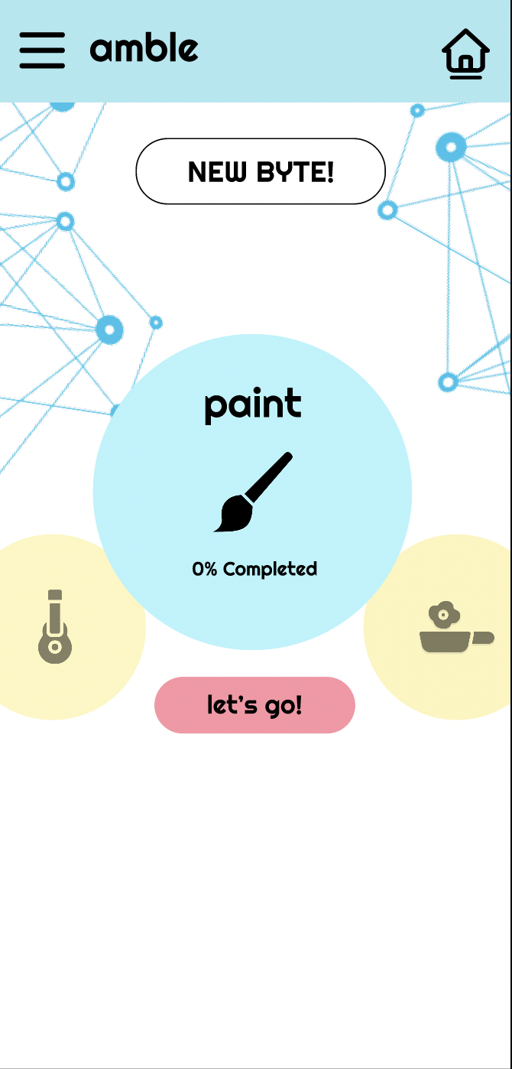
give your creative projects direction!

